Slide 1
The Future of Work is Family-Friendly
Strategies to Support Working Parents
Paige Coleman, Department of Commerce
Ben Robinson, Karen Langehough, & Susan Meenk FirstRule Group
09/19/2023 NHRMA Conference, Tacoma, WA

Slide 3
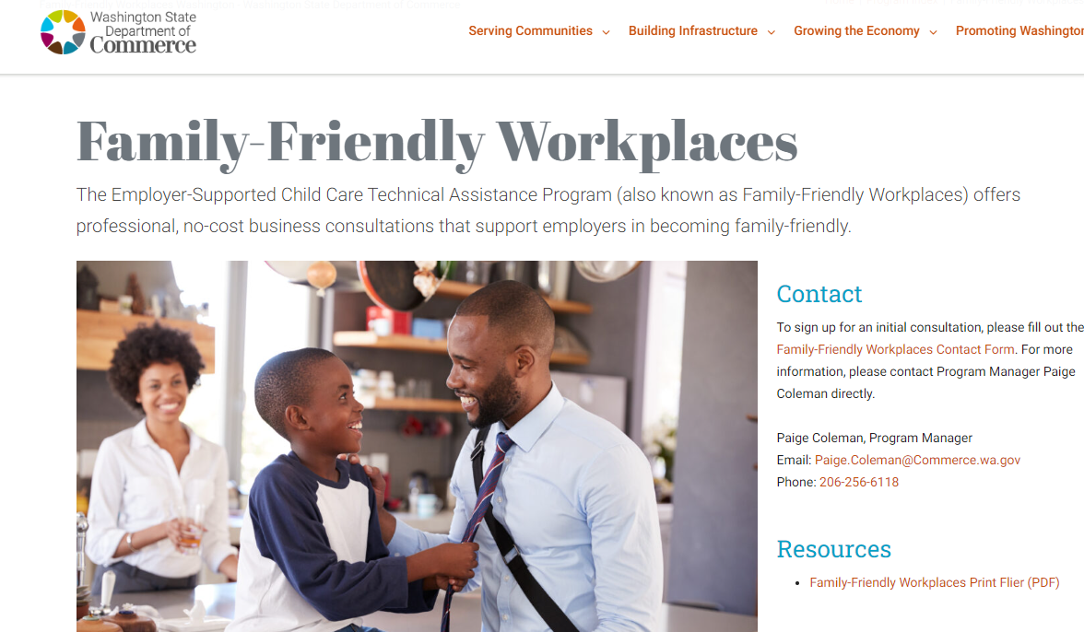
Workforce Strategy: Family-Friendly
Family-Friendly Workplaces
Employer Consultations
Technical Assistance Workshops
Strategies, Assessments, Feasibility, and Implementation support.
HR and Finance Expertise
One of three childcare related programs at WA Commerce
Child Care Partnership Grants
Early Learning Facilities Program

Slide 4
Landscape
is complicated

Slide 5
0.6 unemployed per opening - nationally
0.9 unemployed per opening Washington
0.7 unemployed per opening Oregon
0.5 unemployed per opening Alaska
173,000 job openings in Washington
112,000 job openings in
Oregon
28,000 job openings in
Alaska
3.8M
voluntary quits- nationally
73% of workforce are care givers- nationally
Increase in elder care priority- nationally
93% have children under age 18- nationally

Slide 6
Real life

Slide 7
Poll #1
What are you hearing from:
Your employees?
Your supervisors?
Your job candidates?
What are you hearing from other employers in your area?

Slide 8
Range of solutions
Employer Strategies
Information Referral
Flexible
Schedules
Financial
Contributions
Employee
Benefits
Child
Care
Employee resource
groups
Information sharing
Workplace culture
Remote work
Consistent
scheduling
Non-traditional
schedules
Staggered shifts
Job share
Child care contributions
Flexible spending
(DCAP/etc.)
Employee assistance program (EAPs)
Unlimited paid time
off
Flexible leave
Paid parental / guardian leave
Build on-site child care center
Secure slots at
existing child care
Bring child to work
Backup child care
Community partnerships

Slide 9
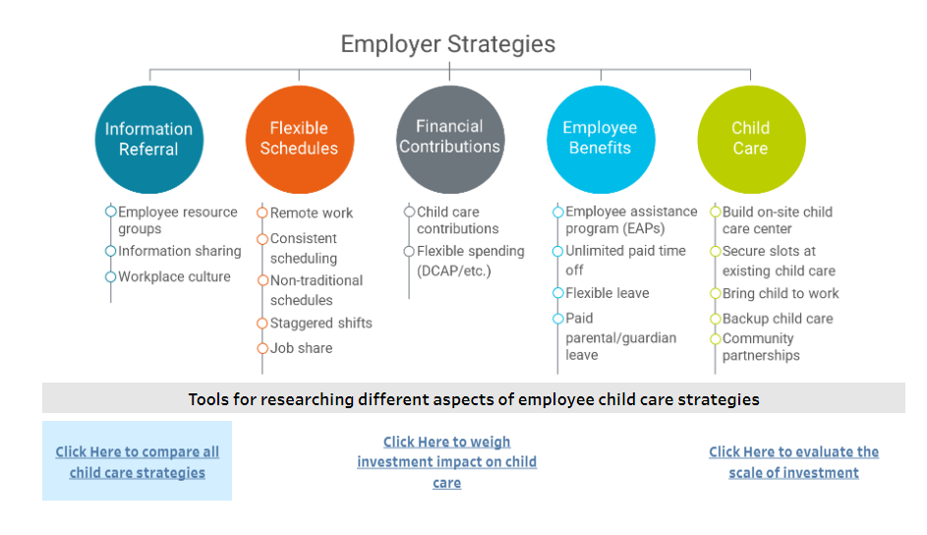
Strategic ROI Tools
Three interactive strategy investment assessment tools
Compare all 19 strategies
Weigh investment impact on child care
Evaluate the scale of investment
Identify top strategies for your business with expert at no-cost

Slide 10
ROI for Family-Friendly policies
Improve recruitment and retention.
Solutions for businesses of all sizes
“Is what you’re offering better than what I have now?”

Slide 11
Poll #2
Polling Questions to be displayed on screen & results displayed as responses received
Are you currently offering family-friendly workplace solutions?
Which categories of solutions are you offering?
Are there strategies that you are considering or would like to add? If so, which one(s)

Slide 12
Approach considerations

Slide 13
Scenario 1 – Flexible schedules
Separation Anxiety at Drop-off
Work with person next to you
What would you do
What strategy or strategies would you consider

Slide 14
Scenario 2 – Financial contributions
Can I afford to keep working here?
Work with person next to you
What would you do
What strategy or strategies would you consider

Slide 15
Scenario 3 – Child Care Resources
How do I recruit families?
Work with person next to you
What would you do
What strategy or strategies would you consider

Slide 16
Workplace Culture: How can employers be viewed as family-friendly?
Authenticity
Consistency
Training

Slide 17
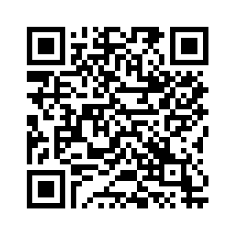
We’re here to help!
Contact us for more information
Schedule a brief call with us

Slide 18
Questions?
Paige Coleman, MBA
Program manager
206-256-6118
Paige.coleman@commerce.wa.gov
Use QR code to contact us for more information or to sign up

Slide 19
Thank you!
Paige Coleman
Program manager
paige.coleman@commerce.wa.gov
206-256-6118

